Slide 1
Attention Is All You Need
Yuechen Yang

Slide 2
The paper proposed a new network architecture, the Transformer, based solely on attention mechanisms.
The Transformer is more parallelizable and require less time to train

Slide 3
Overview: Model Architecture
The Transformer contains Encoder and Decoder parts. Each of them contains 6 identical layers.
For Encoder, each layer has 2 sub-layers. The first is a multi-head self-attention mechanism, and the second is a simple, position-wise fully connected feed forward network.
The Decoder is also composed of 6 identical layers. In addition to the two sub-layers in each encoder layer, the decoder inserts a third sub-layer, which performs multi-head attention over the output of the encoder stack.
An attention function can be described as mapping a query and a set of key-value pairs to an output, where the query, keys, values, and output are all vectors. The Transformer model in this paper uses the "Scaled Dot-Product Attention“.
The link to the repo

Slide 4
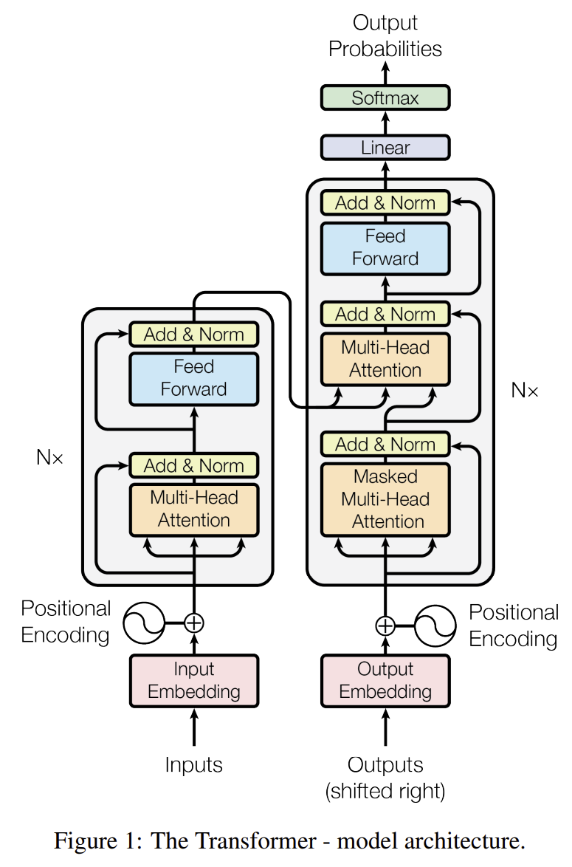

Slide 5
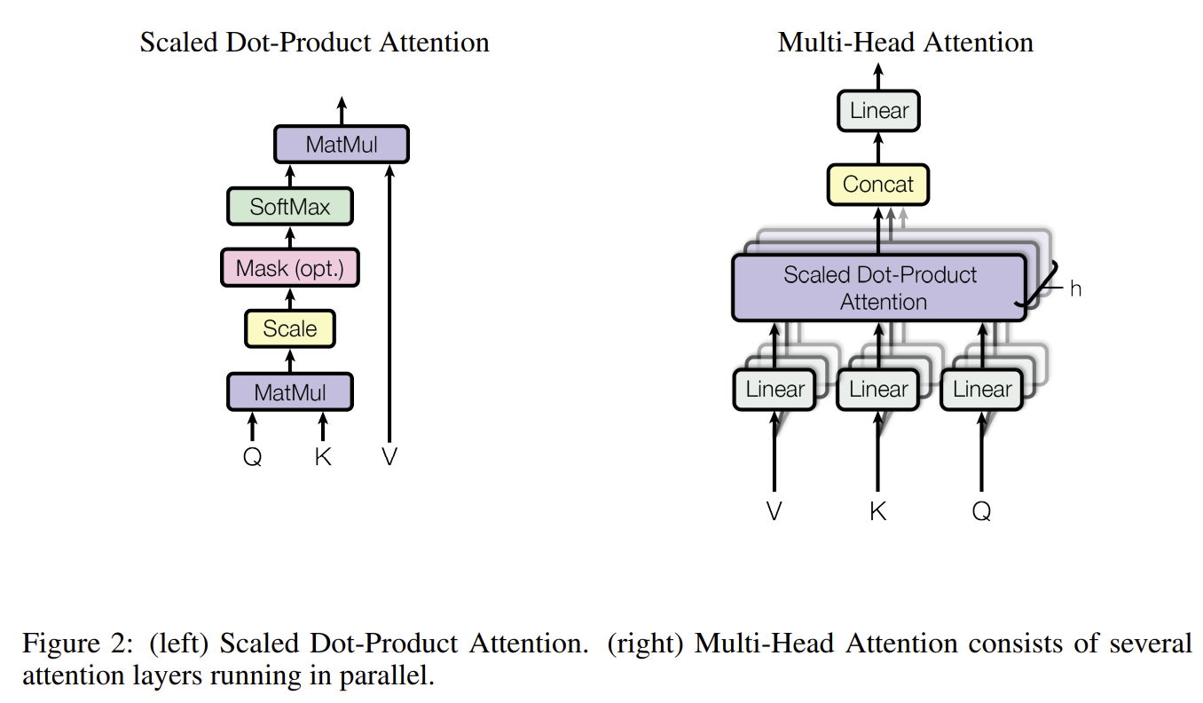
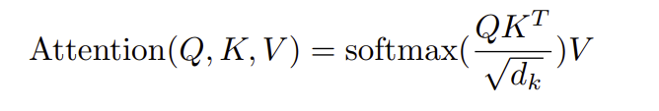

Slide 6
Three Discussion Topics
Why the Masked Multi-Head Attention need to have “Masked”?
Why there is Multi-Head Attention?
Why there is attention?

Slide 7
Critical Analysis
The paper proposed a new model architecture, and it is only implemented in the translation.
I think each part in the transformer could be explained in a more detailed way.
The transformer contains 2 parts in this paper. But they can also be used in a separate way, such as BERT and GPT.
I think the attention mechanism could make the deep learning model more explainable.

Slide 8
Resource links
Original Article: https://arxiv.org/abs/1706.03762v5
Tensor2Tensor has some code with a tutorial: https://www.tensorflow.org/text/tutorials/transformer
Transformer very intuitively explained: http://jalammar.github.io/illustrated-transformer/
Code demonstration
The link of the notebook
repo
The link to the repo
Video Recording
The link to the video recording

